Slide 1
Android Architecture
Android system architecture contains the following components:
Application framework. The application framework is used by application developers.
Binder IPC. Enables high level framework APIs to interact with Android system services. The Binder Inter-Process Communication (IPC) mechanism allows the application framework to cross process boundaries and call into the Android system services code.
System services. System services are modular, focused components such as Window Manager, Search Service, or Notification Manager.
Android includes two groups of services:
system (such as Window Manager and Notification Manager) and
media (services involved in playing and recording media).

Slide 2
Hardware abstraction layer (HAL).
A HAL defines a standard interface for hardware.
This enables Android to be agnostic about lower-level driver implementations.
Using a HAL allows you to implement functionality without affecting or modifying the higher level system.
HAL implementations are packaged into modules and loaded by the Android system.
Linux kernel.
Android uses a version of the Linux kernel with a few special additions such as
Low Memory Killer (a memory management system that is more aggressive in preserving memory).
wake locks (a PowerManager system service)
The Binder IPC driver, and other features important for a mobile embedded platform.

Slide 3
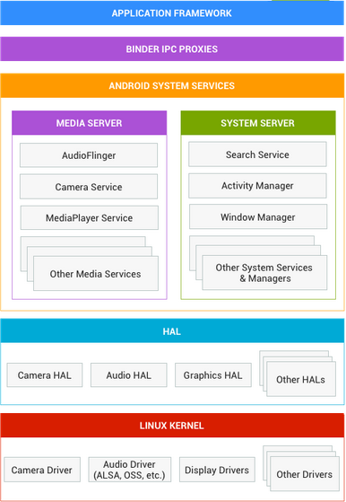

Slide 4
Android Boot Sequence:
Boot ROM
  Is executed as soon as the power button is pressed.
  The point of origin for the code is a predefined, hardcoded location.
  Loads the bootloader into the RAM and executes it.
Bootloader
  Detects the RAM
  Set up low-level memory management.
  Set up security options.
  Set up the network etc.
  In the source code it is located at /bootable/bootloader/legacy/
    It contains two very important files, namely, init.s and main.c
    init.s file initializes stacks, zeroes and BSS segments
    It then proceeds to initialize call_main() in main.c

Slide 5
  The main.c file initializes the hardware, such as the clock, console, and keyboard
  Loads the linux kernel.
Linux Kernel
  The kernel sets the cache, protected memory.
  Loads drivers and initializes them.
  /root file system is mounted.
  Loads the init process from the system files.
Init process
  Its the first process PID1.
  Initializes main elements of Android System
  The Android init program process two files, executing the commands which it finds in them.

Slide 6
  First one is generic init.rc, common for all Android Devices.
  The the second one init.<machine_name>.rc is device-specific (example init.flo.rc for Nexus 7).
  In these files, commands that are responsible for starting processes are defined such as:
    Android Debug Bridge Daemon (adbd) to manage ADB connections.
    Debugger Daemon (debuggerd) to manage debug processes requests (dump memory, etc.)
    Radio Interface Layer Daemon (rild) to sit on top of the radio baseband interface to manage communication with the radio.
    launch the boot animation. etc

Slide 7
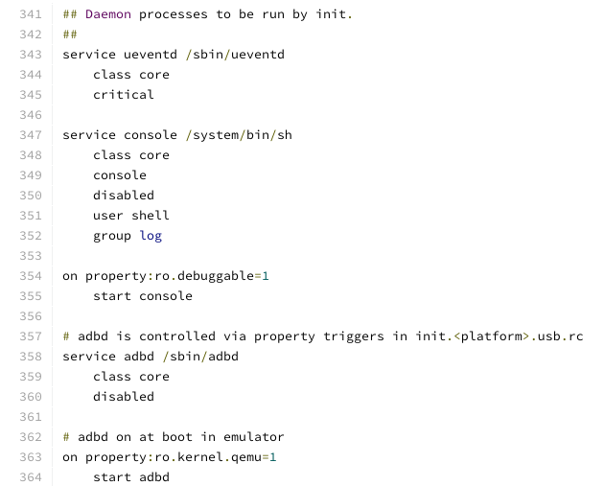

Slide 8
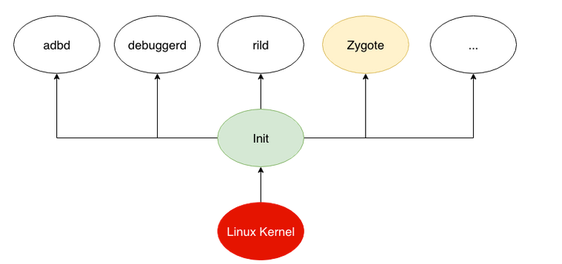
Zygote
  After starting up the daemons, the init process starts up a process called Zygote.
  Zygote process is basically a ART/Dalvik VM loaded with all standard core packages (like java.util.HashMap etc).
    When it’s loaded it goes to sleep.
    When new Application is required to start, the system sends an Intent to that process (with a message similar to “execute com.example.MainActivity”). Zygote process wakes up, fork's and then goes back to sleep.
    The child process, creates a new VM instance and loads the component that was requested eg. com.example.MainActivity)

Slide 9
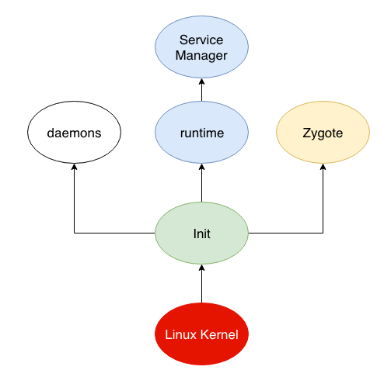
Init starts Runtime process
  Runtime is an instance of class AppRuntime, which is sub-classed from AndroidRuntime
  Runtime process does one very important thing
    It starts the Service Manager and this is really the Context manager for Binder, that handles service registration and lookup (like DNS)
    It registers Service Manager as default context manager for Binder services.

Slide 10
Dalvik VM and System Server
  Zygote forks a new ART/Dalvik VM instance and starts the System Server.
  System Server starts system servers like Surface Flinger, Audio Flinder and System Services like:
    Entropy Service
    Power Manager
    Activity Manager
    Telephony Registry
    Package Manager
    Battery Service
    and others ...
  All of these services register to the ServiceManager

Slide 11
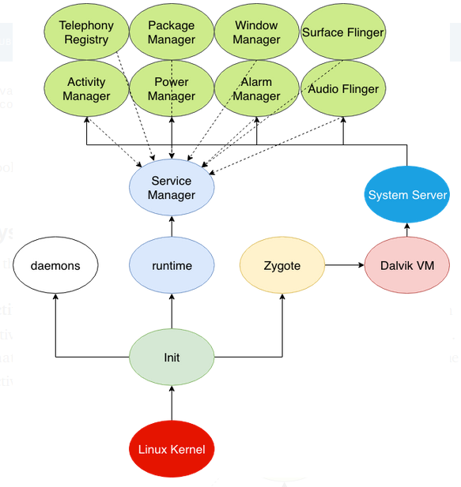

Slide 12
THE END

